Slide 1
Abstract
This presentation is intended to be an introduction to the DCAF framework for someone who hasn’t used it before but that has experience working with embedded systems and LabVIEW. It can be used either as a stand alone presentation or as the introduction for the DCAF Training Class.
For a training class, some of the slides are hidden since they will be reviewed with more detail in later presentations. For a stand alone scenario, feel free to make them visible.

Slide 2
Distributed Control and Automation Framework (DCAF)
Introduction to DCAF
Instructor Name
Instructor’s role
Notes:
People that contributed with this content:
Benjamin Celis
Mathew Pollock
Simon Perez
Andres Gomez
Matt Jacobson

Slide 3
Agenda
Introduction
Why should you use DCAF?
Who should use DCAF?
Getting Started (Demo)
The DCAF Paradigm
Engine
Modules
Configuration Editor
Quiz

Slide 4
Introduction

Slide 5
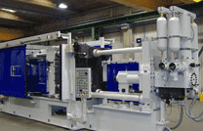
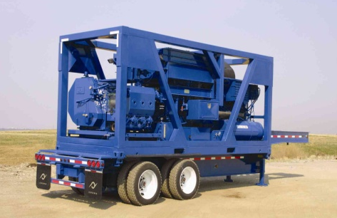

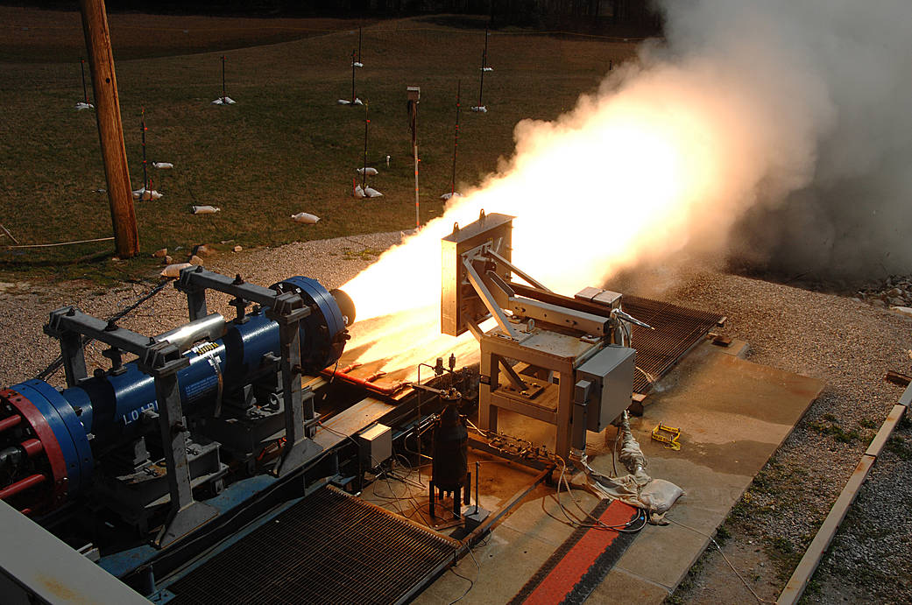
Programming Embedded Control Applications is Hard
RT, FPGA, and user interface programming
Distributed I/O and execution
High cost of failure
Execution guarantees
Understand failure root cause
High availability
System commissioning
Software updates and deployments
Multi-developer teams
Error handling
Plus the crazy things it actually has to do!
Manufacturing Machines
Oil and Gas
Power Conversion Equipment
Aero Space
Notes:
RT, FPGA, and UI programming can vary widely in style and knowledge requirements. Being proficient in all three takes both training and experience.
Distributed I/O and execution means a variety of communication protocols to learn. CAN, EtherCAT, UDP, TCP, AMQP, and possibly even the upcoming IIoT protocols may all be involved.
Execution guarantees require knowledge of deterministic programming techniques. Understanding why something failed requires built-in diagnostics and good error handling.
High availability means programs need to be able to run for months or longer without stopping. They also need to be able to recover from a failure automatically.
No two machines are exactly the same. Tuning, features, parameters often need to be tweaked during setup. This requires extensive and powerful parameterization, which ideally is built into the code before it is needed.
These machines are typically built to last. Development teams need a strategy for how to get updates to the code. How do bug fixes or new features get deployed reliably?
These systems are often complex enough and with a tight enough timeline to require multiple software developers. Multi-developer teams don’t work efficiently overnight, and require training and process investments to really flourish.
To top it all off, the functionality for these machines in terms of their primary tasks are complex and getting even more so. It also needs to do those tasks better than the competition.

Slide 6

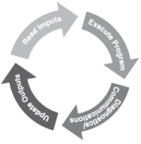


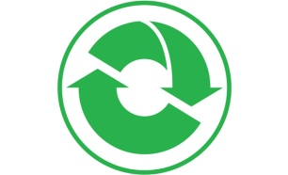



Distributed Control and Automation Framework (DCAF) Overview
An open-source LabVIEW framework for creating configurable, latest value, data engines that can acquire data from multiple input sources, process that data, and then route it back to outputs or to data services.
Create higher quality control applications, in less time.
Scalable and extensible plugin
architecture
Develop with plugin templates
Reuse existing plugins
Define and configure plugin
parameters
Single point I/O, processing, and
data services
Rules for correct-by-construction
software
Configure timing and error handling
Optimized for real-time execution
Notes:
The Tag Bus Data Framework or TBDF is an open-source LabVIEW framework for creating configurable, latest value, data engines that can acquire data from multiple input sources, process that data, and then route it back to outputs or to data services. It provides a scalable and extensible plugin architecture. It supports users in the development of new plugins with a variety of templates… …and the framework was designed to allow plugins to be reused easily across projects. Reuse is easy because each plugin can define configuration parameters which can be specified using a configuration editor. This also allows plugin behavior to change across multiple deployments of the same application. While applicable to a wide variety of use-cases, the framework was primarily built for applications using a lot of single point I/O: things like control data or industrial communication protocols. The plugin architecture helps facilitate multideveloper teams, and the framework handles the intricacies of execution timing and error handling for its users. Finally, while the framework can run on RT, Windows, and Interact with FPGAs, it was built primarily for applications executing on a real-time OS.

Slide 7
Why did we create the framework?
Writing good embedded applications is Hard
Many concepts and good practices are required to write good embedded code
Most embedded applications have the same components in common
Most embedded applications are dynamic and need configuration
All applications need error handling

Slide 8
Who should use the framework?
New developers in LabVIEW:
Allows them to work on what the application has to do, rather than how they have to do it.
Abstracts Real Time concepts for the user
Provides a configurable I/O Abstraction layer
Forces good programing practices
Advanced developers:
Efficient data mapping engine
Extensible configuration interface
Excellent code reuse between projects
Know LabVIEW but doesn’t want to write too much architecture
Open source and distributed in components that are useful individually

Slide 9
Who is DCAF for?
Application Type: Control and Automation
Single-point I/O, processing, and services
Outputs provided in real-time
Not Real-Time Test
Not Monitoring or Data Acquisition*
Scope Type: Deployed Solution
Built product (internal or external)
Project time measured in months
Not a Simple Demo/POC
Tool Type: LabVIEW
Some LabVIEW experience needed
Shared memory integration with C/C++ apps
Not Ladder/61131 developers
Control
Solution
LabVIEW
Notes:
DCAF was designed specifically to help people build better control solutions in LabVIEW. There are plenty of other ways to take advantage of the framework and its components in other applications areas, but control is the main target today. The last thing we want is for anyone to use the framework for the wrong job.

Slide 10
Getting Started

Slide 11
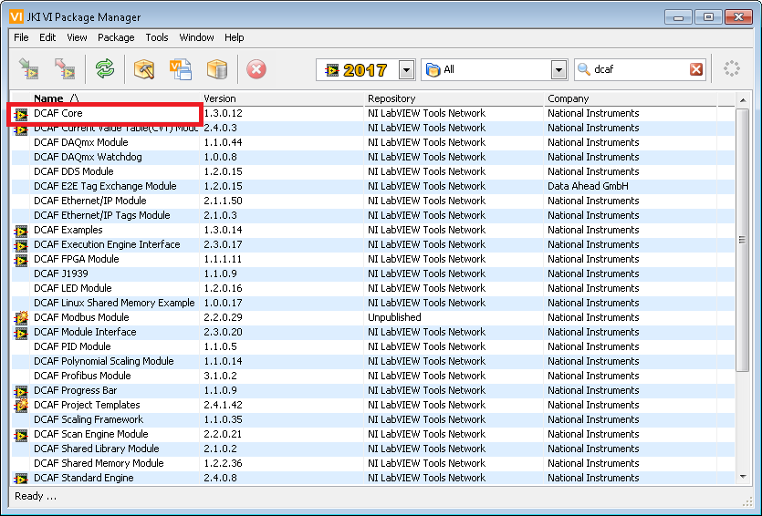
Installing DCAF

Slide 12
Getting Started
Create a project with the Execution Template
Open the Editor from the Tools menu
Configure the system in the Editor
Populate Includes VI
Save the Configuration
Load the Configuration using the template VI.
Notes:
Feel free to execute the demo your self or use the gifs in the next slides

Slide 13
Standard Configuration Editor

Slide 14
Creating the System Hierarchy

Slide 15
Create and Map Tags

Slide 16
Configure Modules

Slide 17
Deploy Configuration

Slide 18
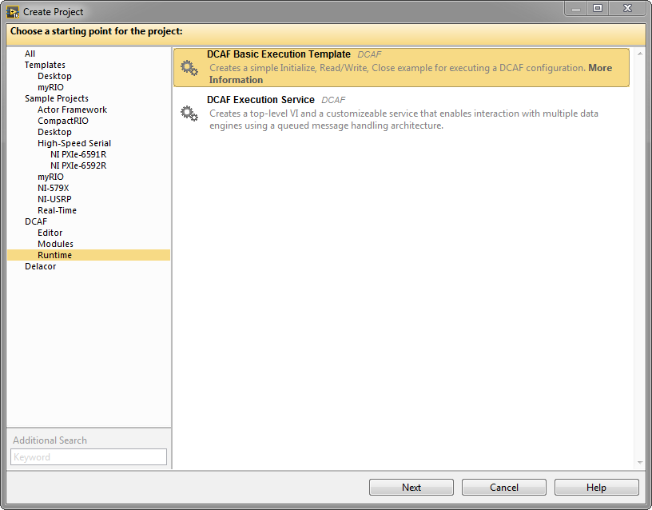
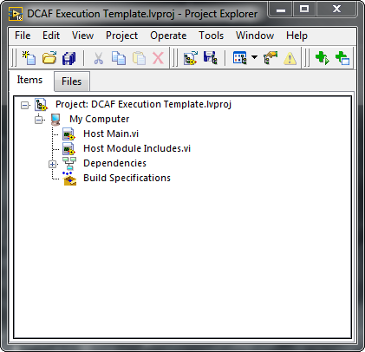
DCAF Project Templates
Notes:
Application templates exist in addition to the plugin templates.

Slide 19
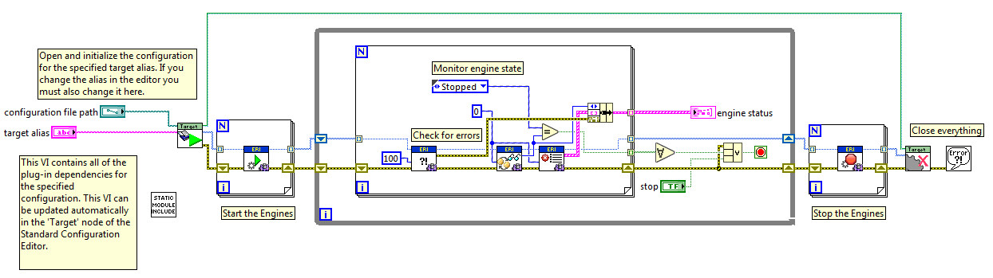
Running the Configuration

Slide 20
The DCAF Paradigm

Slide 21
DCAF Components
Engine: State machine that executes Modules as defined in the Configuration Editor and provides a namespace for Tags. The Engine also passes data between its Modules according to its Mappings.
Module: A collection of code of varying functionality that executes within an Engine and that can interact with the Tags of that Engine. Some standard Modules are installed with DCAF, but users can also create their own.
Configuration Editor: A LabVIEW program used to visually define the functionality of each Engine and Module in DCAF.
Editor
Engine
Modules

Slide 22
DCAF Components
Project Templates
Configuration
Runtime
Templates
Configuration Editor
Engine
Examples
Modules
Notes:
From DevGuide
**Engine**: State machine that executes *Modules* as defined in the *Configuration Editor* and provides a namespace for *Tags*. The Engine also passes data between its *Modules* according to its *Mappings*.
**Module**: A collection of code of varying functionality that executes within an *Engine* and that can interact with the *Tags* of that *Engine*. Some standard *Modules* are installed with DCAF, but users can also create their own.
**Configuration Editor**: A LabVIEW program used to visually define the functionality of each *Engine* and *Module* in DCAF.

Slide 23
Module Components
Configuration
Editor node
Runtime
Editor Node
User interface
Runs on PC
Creates or modifies the configuration
Contains the configuration class
Editor
Engine
Modules

Slide 24
Module Components
Configuration
Editor node
Runtime
Runtime Node
Initializes runtime based on configuration
Provides execution logic
Editor
Engine
Modules

Slide 25
Module Components
Configuration
Editor node
Runtime
Configuration
Created on PC, passed to runtime system
Provides data access and serialization/deserialization methods
Data storage only, no editor or runtime logic
Editor
Engine
Modules

Slide 26
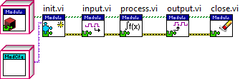
Module Runtime
Editor
Engine
Modules

Slide 27
DCAF Modules
Existing
Modbus
Scan Engine
UDP
LED
Profibus
Ethernet/IP
Scaling
Tag Select
UI
CVT
TDMS
FPGA
DAQmx
…
New
DDS
J1939
Shared Memory
PID
SystemLink
In Work
Alarms
OPC UA Client
TSN
Editor
Engine
Modules

Slide 28
DCAF Engine
Engine
Init
Input
Process
Output
Close
Input
Process
Output
Input
Process
Output
Outside
Outside?
Outside
Editor
Engine
Modules

Slide 29

Engine Execution Model
DCAF Execution Engine
Run State
Shutdown
Idle
Tag Bus
Inputs
Process
Outputs
Upkeep
Wait
Configuring
Plugin1
Plugin3
Plugin1
Fault Recovery
Plugin2
Plugin4
Plugin5
House-Keeping
Safe State
Editor
Engine
Modules
Notes:
State machine with a safe state
Sequentially executes Input, Process, and Output methods of each plugin
Passes latest value data between plugins
Configurable execution timing
Built-in error reporting and recovery
Prevent Race conditions, memory allocations, thread starvation, etc.

Slide 30
Tags
Engine Scope
Have Data Type
Unique Name
Only one writer
Multiple readers
Channels
Module Scope
Have Data Type
Unique Name
Have Flow Direction
Engine
Tag
Input Module
Channel

Slide 31
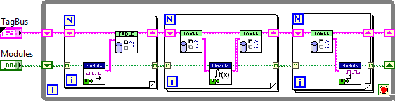
Simplified Engine
Editor
Engine
Modules

Slide 32
Tag Bus
Current Options
Local Variable
Global Variable
Single
Functional Global Variable
Current Value Table (CVT)
Requirements
Flexibility
Scope
Performance
Editor
Engine
Modules
Notes:
DCAF was designed for systems in which the main data transfer is tags.
LabVIEW offers many options to manage tags.
But for design we had 3 main guidelines and they could not be achieved with the current options.
What's the need?
Limited Solutions:
Variables
CVT
Scope
Data Types

Slide 33

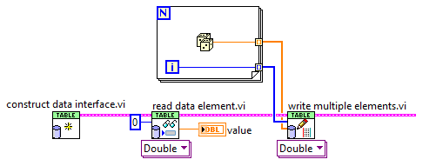
Tag Bus
CVT on the wire
Controlled Scope
Data Protection
Fast
Reduced memory copies
Filtering

Slide 34
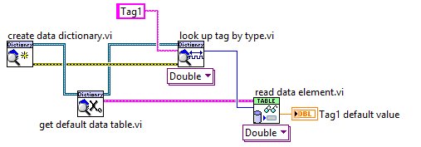
Tag Bus - Data Dictionary

Slide 35
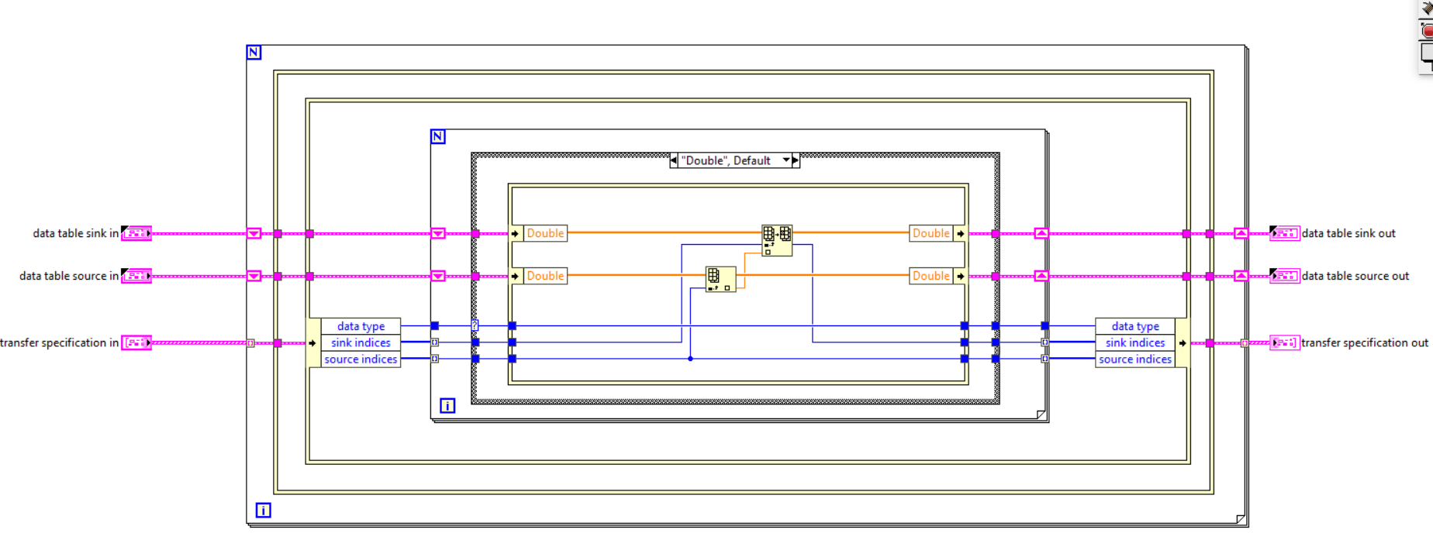
Tag Bus - Duplication
Notes:
Major issue with clustersauruses: data copies of the cluster and accidentally stomping on data, especially if sending the whole cluster into every user of the cluster
Solution: break up the cluster such that each user of the cluster gets the minimum data set it needs and prevent useless data copies when getting/setting the values from the main cluster
Each DCAF module gets a “mini” tag bus containing only the data used by that module. Scripting templates take care of all data access operations on the mini-tag bus in the module for most common use cases.
Use of in-place operations, plus never branching the main tag bus wire, prevent copies of the main cluster

Slide 36
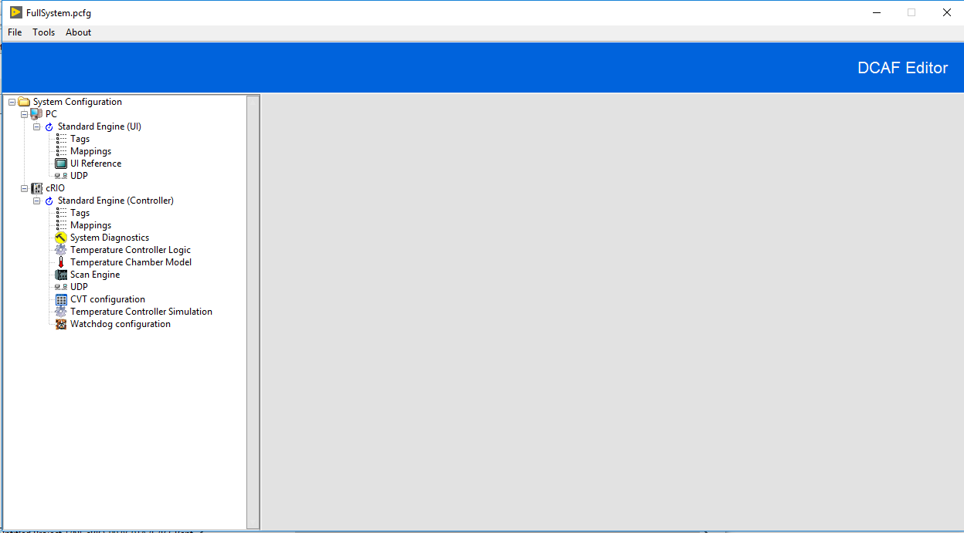
Configuration Editor Framework (CEF)
Open Source Library
Tools to manage tree control and subpanels
Can be extended and customized
3 starting templates available
Editor
Engine
Modules

Slide 37
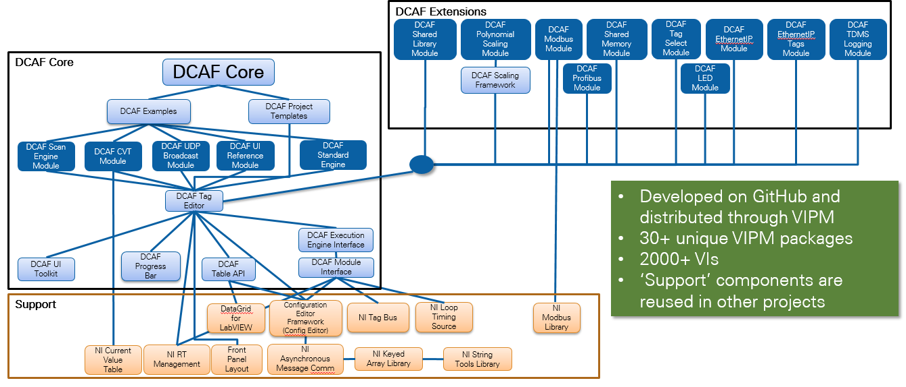
DCAF Package Dependency Diagram
Notes:
Useful for navigating Tools Network packages and GitHub Repos
May be the largest open source LabVIEW development project

Slide 38
Resources

Slide 39
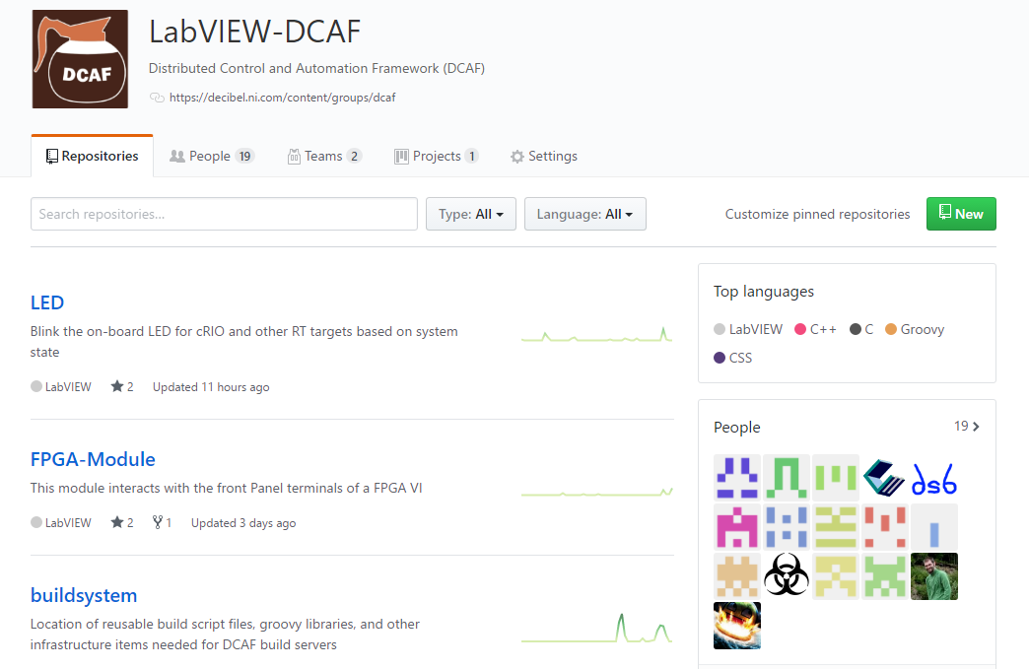
Resources
ni.com/DCAF
Getting started material
Support forum
github.com/LabVIEW-DCAF
Issue reporting
Pull requests welcome!

Slide 40
Quiz

Slide 41
What are characteristics of DCAF?
Scalable and extensible plugin architecture.
Better suited for waveform processing.
Includes framework for error classification and handling.
Only supported for Real-Time targets.
Notes:
A and C

Slide 42
What are characteristics of DCAF?
Scalable and extensible plugin architecture.
Best suited for waveform processing.
Includes framework for error classification and handling.
Only supported for Real-Time targets.
Notes:
A and C

Slide 43
DCAF is not recommended for users with a lot of experience programming embedded systems using LabVIEW Real-Time
True
False
Notes:
B

Slide 44
DCAF is not recommended for users with a lot of experience programming embedded systems using LabVIEW Real-Time
True
False
Notes:
B

Slide 45
DCAF is a good solution to avoid having to learn programming in LabVIEW
True
False
Notes:
B

Slide 46
DCAF is a good solution to avoid having to learn programming in LabVIEW
True
False
Notes:
B

Slide 47
List the three main components of DCAF and their functionality
Engine: State machine that executes Modules as defined in the Configuration Editor and provides a namespace for Tags. The Engine also passes data between its Modules according to its Mappings.
Module: A collection of code of varying functionality that executes within an Engine and that can interact with the Tags of that Engine. Some standard Modules are installed with DCAF, but users can also create their own.
Configuration Editor: A LabVIEW program used to visually define the functionality of each Engine and Module in DCAF.
Editor
Engine
Modules

